Slide 1

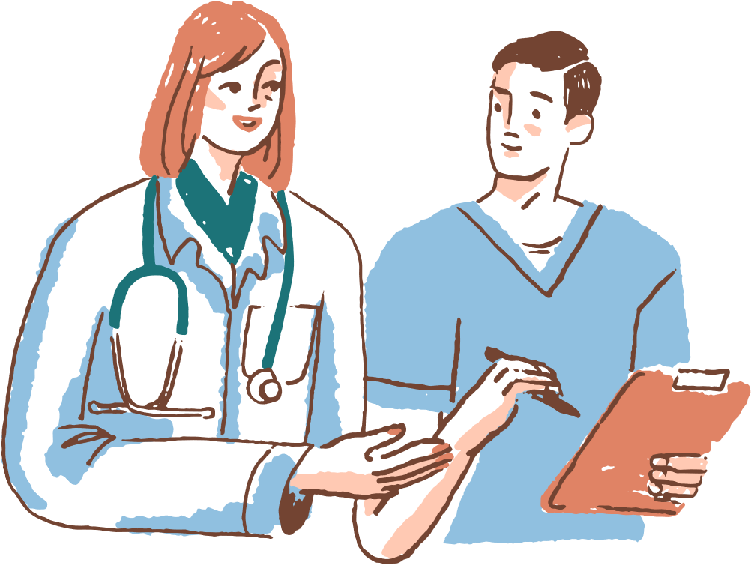
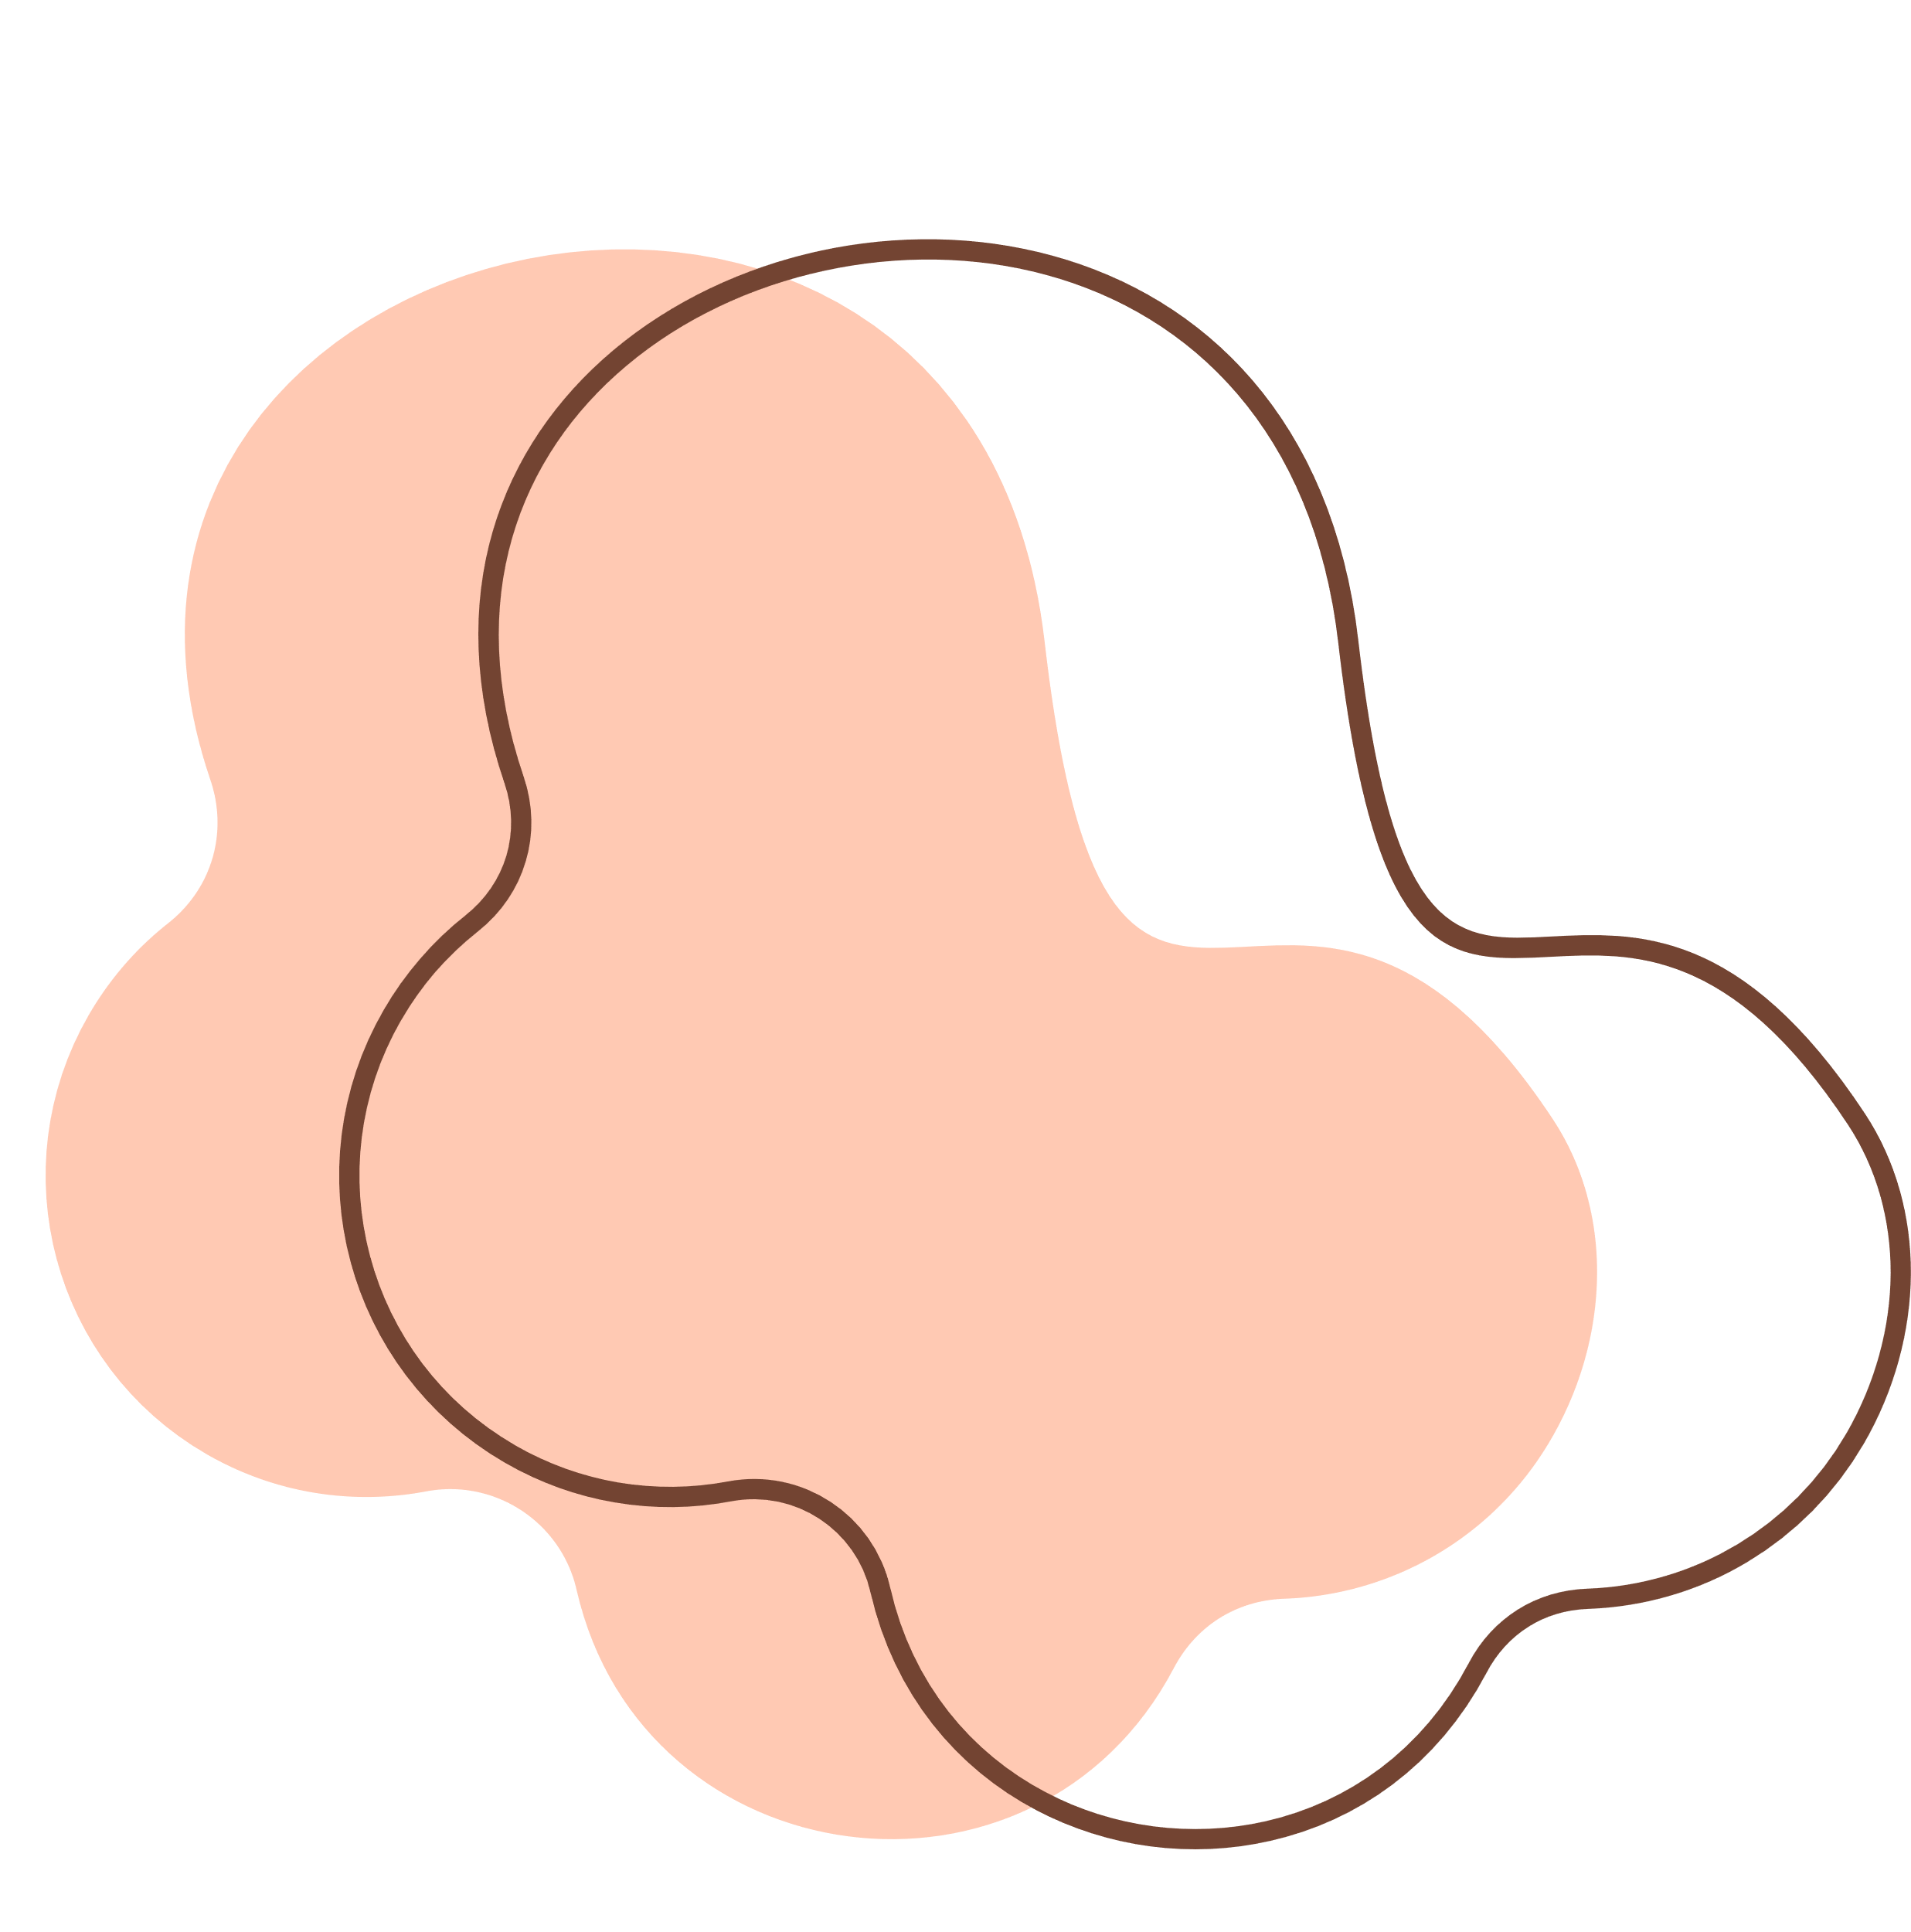
Title: Multi-Disease Chest X-ray Classifier Using
Explainable AI
Name : Raj Koyani
Reg no : 21MIS1017
Guide : Dr.Brindha V

Slide 2
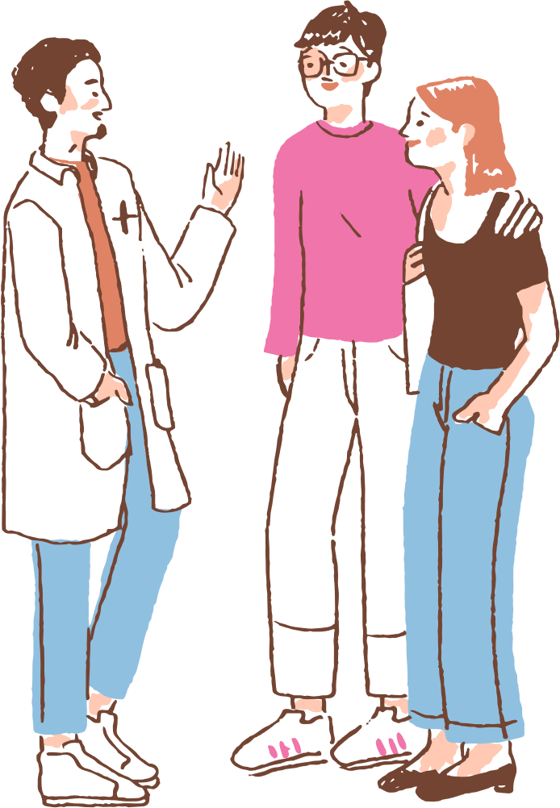
TODAY'S AGENDA
1. Introduction
2. Literature Review
3. Scope and Problem Statement
4. Research Challenges
5. Research Objective
6. Methodology
7. Dataset Description
8. Output, Conclusion and Future work
9. References

Slide 3
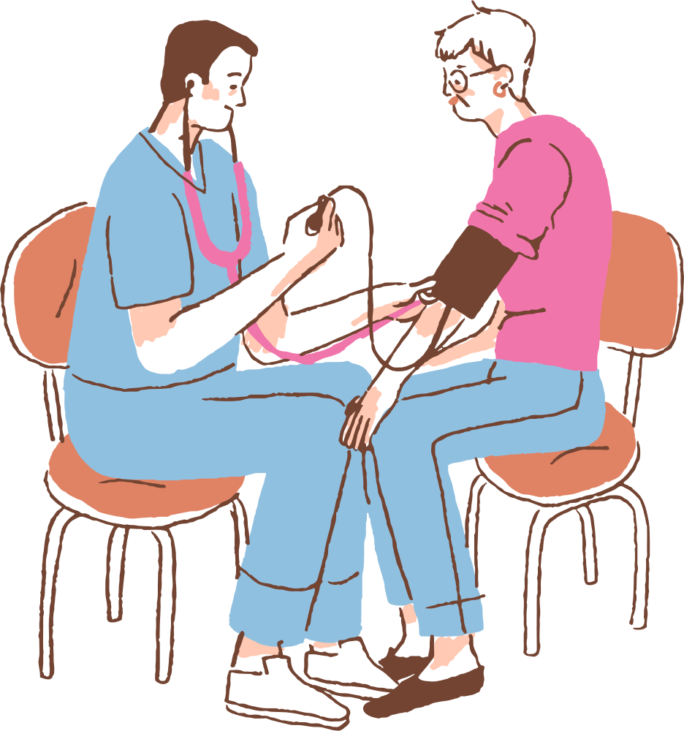
INTRODUCTION
The goal of this project is to develop a deep learning-based multi-disease chest X-ray classifier using DenseNet121 , Swin-Transformer integrated with GRADCAM The system is designed to classify multiple respiratory diseases such as Viral Pneumonia, Tuberculosis (TB), COVID-19, and Lung Opacity, Normal. Additionally, the model is equipped with Explainable AI capabilities like Grad-CAM, which will help visualize the regions of the chest X-ray most relevant to the model's prediction, aiding clinical interpretation and supporting radiologists in diagnosis.

Slide 4

Literature Review
1. "Deep Learning for Chest X-ray Analysis: A Survey"
Authors: A. Rajaraman, A. Sivaswamy
Summary: This paper reviews the application of deep learning techniques for analyzing chest X-rays. It covers different architectures like CNNs, DenseNet, and ResNet, and explores challenges in terms of data quality, model interpretability, and clinical implementation.
2. "COVID-19 Chest X-ray Classification Using Deep Convolutional Neural Networks"
Authors: S. Hemalatha, M. V. Shashidhar
Summary: The paper investigates the use of deep CNNs, particularly DenseNet, for the classification of COVID-19 in chest X-rays. It provides insights into the architectural design and optimization for disease detection in medical imaging.
3. "A Survey on Deep Learning in Medical Image Analysis"
Authors: M. Litjens, T. Kooi, B. Ehteshami Bejnordi, et al.
Summary: This extensive review covers various deep learning techniques applied to medical image analysis, including chest X-rays. The authors discuss architecture-specific performance metrics and challenges, including the use of Grad-CAM for explainability.

Slide 5
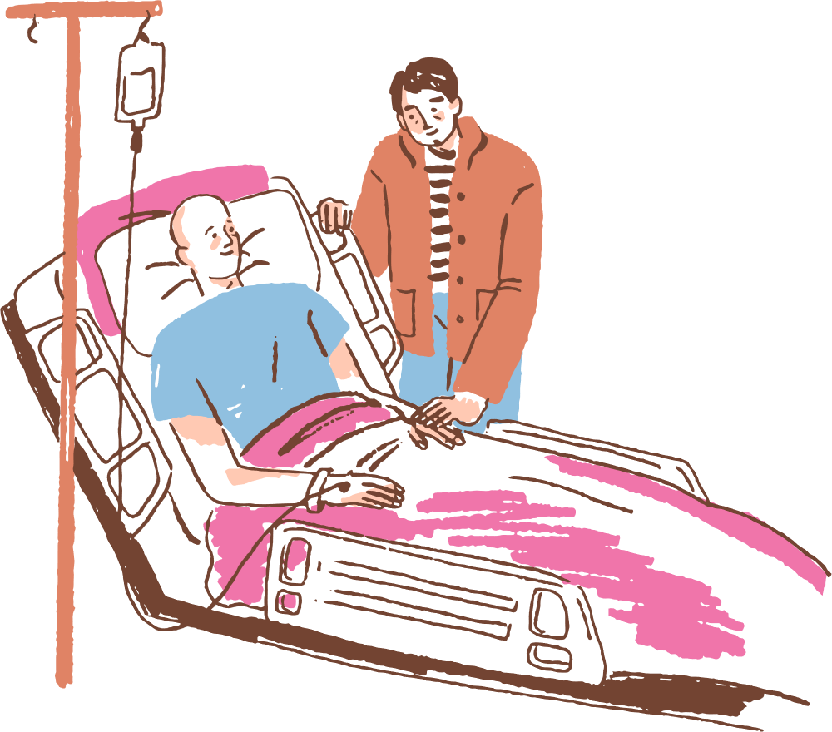
4. "Pneumonia Detection in Chest X-rays Using Convolutional Neural Networks"
Authors: M. L. Iglewicz, M. Salibian
Summary: Focuses on using CNNs for pneumonia detection, comparing different architectures like VGG and DenseNet. The paper explores the effectiveness of automated diagnosis and its potential impact on clinical settings.
5. "Tuberculosis Detection in Chest X-rays Using Transfer Learning"
Authors: T. Singh, R. Ghosal
Summary: This paper presents a study using transfer learning techniques on pre-trained models such as DenseNet and InceptionV3 for detecting tuberculosis in chest X-rays. It emphasizes the importance of fine-tuning for improved accuracy in disease-specific tasks.
6. "Explainable AI for Medical Imaging: A Survey"
Authors: M. T. Ribeiro, S. Singh, C. G. M. dos Santos
Summary: This paper explores the role of explainable AI (XAI) in medical image analysis, with a focus on tools like Grad-CAM. It discusses how explainability aids in model interpretability, particularly in healthcare applications like disease diagnosis from X-rays.
7. "Chest X-ray Classification with DenseNet and Attention Mechanisms"
Authors: H. Zhang, Y. Zhang, Y. Chen
Summary: This paper proposes integrating attention mechanisms like CBAM with DenseNet for improved classification of chest X-rays. It showcases how attention models can help the network focus on more critical areas of the image for disease classification.
.

Slide 6
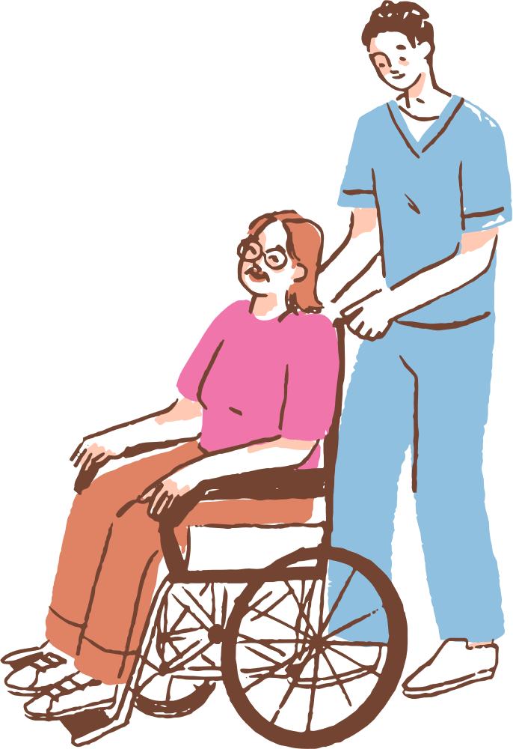
8. "Deep Learning for Pneumonia Classification in Chest X-rays Using Transfer Learning"
Authors: L. Xie, Q. Lin
Summary: The study demonstrates how transfer learning with pre-trained DenseNet and ResNet can significantly enhance pneumonia classification accuracy on chest X-rays. The research also highlights the issue of data scarcity and the need for better pre-processing methods.
9. "A Deep Learning Framework for Detection of COVID-19 from Chest X-ray Images"
Authors: A. R. D. K. Chowdhury, M. F. Bhuiyan
Summary: This paper applies deep learning techniques, including DenseNet, to detect COVID-19 from chest X-rays. It discusses how the model was trained on various public datasets and provides a comparison with other existing models.
10. "Integration of Deep Learning and Explainable AI for Medical Imaging"
Authors: J. T. K. Lee, S. C. Choi
Summary: This paper combines deep learning with explainable AI methods like Grad-CAM to provide interpretable results in medical image analysis. The paper focuses on enhancing the trust and adoption of AI-based models in the medical field.
11. "Multi-Class Chest X-ray Classification Using DenseNet with CBAM Attention"
Authors: R. Kumar, N. S. Narayan
Summary: This paper presents a multi-class classification approach using DenseNet combined with the CBAM module for chest X-ray images. The study highlights how attention mechanisms improve performance and interpretability for multi-disease classification tasks.

Slide 7
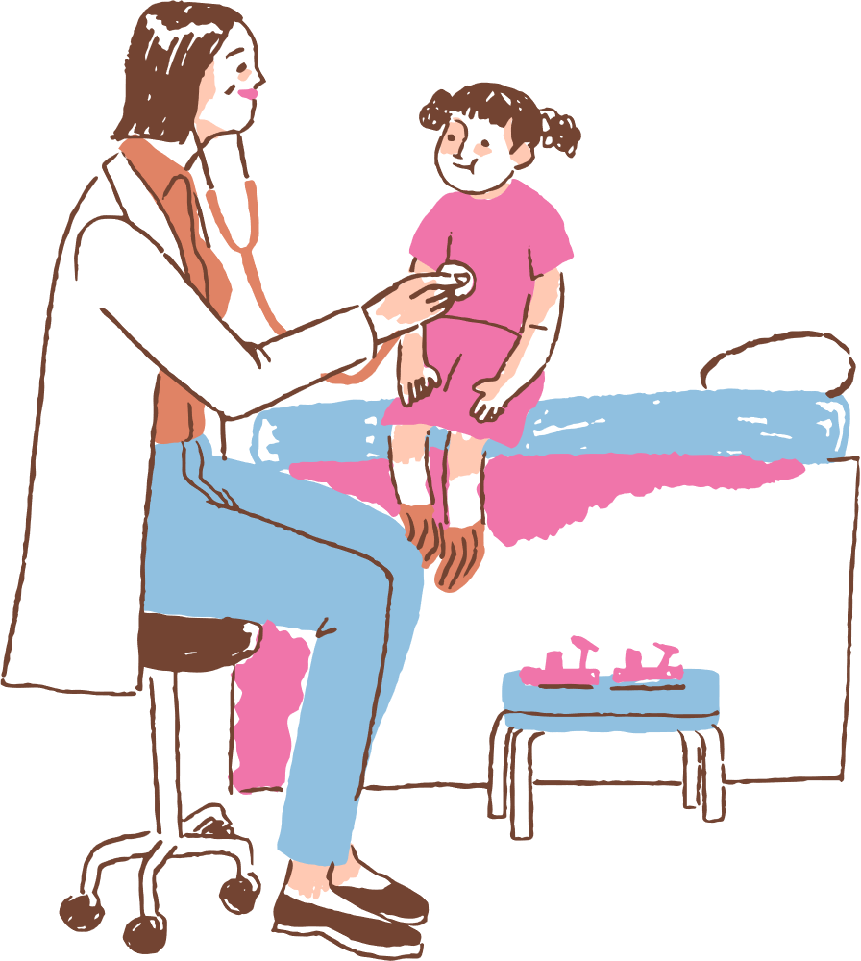
Scope and Problem Statement
Scope:
The project develops a hybrid AI model integrating DenseNet121 and Swin Transformer for multi-disease detection.
Detects five classes: COVID-19, Lung Opacity, Tuberculosis, Viral Pneumonia, and Non-chest images.
Integrates Explainable AI tools (Grad-CAM, SHAP) for interpretability.
Deploys through a Streamlit-based web app for clinicians.
Designed for scalability, real-time inference, and clinical adoption.
Problem Statement :
Radiologists face challenges such as:
Subjective interpretation
Limited availability in rural areas
Fatigue and diagnostic variability
Existing AI models:
Focus on single-disease classification
Lack transparency
Struggle with data imbalance
Objective Problem: “Develop an Explainable Deep Learning system that can classify multiple respiratory diseases from Chest X-rays while providing interpretable heatmaps for medical validation.”

Slide 8

Research Challenges
Data Imbalance:
Uneven sample counts (e.g., TB: 700 vs. Lung Opacity: 6012).
Causes model bias toward majority classes.
Image Quality Variability:
Different contrast, lighting, and equipment sources affect feature consistency.
Overlapping Disease Patterns:
COVID-19 and Viral Pneumonia both show ground-glass opacities.
Interpretability:
Medical professionals need transparency for trust and validation.
High Computational Demands:
Transformer models require GPUs and large memory.
Privacy & Ethics:
Compliance with HIPAA/GDPR for medical data use.
Real-World Deployment:
Integration with hospital systems and usability for non-technical users.

Slide 9


Research Objective
Technical Objectives:
Design a hybrid deep learning model combining DenseNet121 (CNN) and Swin Transformer.
Implement Convolutional Block Attention Module (CBAM) to focus on disease-relevant regions.
Integrate Explainable AI (Grad-CAM, SHAP) for transparency.
Analytical Objectives
Evaluate model using:
Accuracy, Precision, Recall, F1-Score, AUROC
Confusion Matrix (per class)
Benchmark against baseline models like ResNet50 and DenseNet121.
Practical Objectives:
Develop a Streamlit Web App for real-time classification and heatmap visualization.
Design a clinician-friendly UI requiring no technical knowledge.

Slide 10
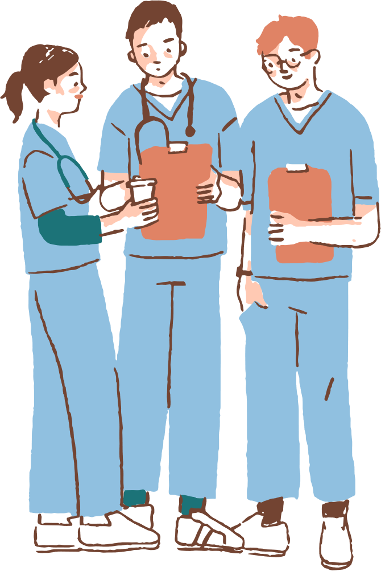
Methodology
1. Overall Workflow
Steps:
Dataset Collection – 16,549 X-ray and non-X-ray images
Preprocessing – Grayscale conversion, resizing (256×256), equalization
Model Development – DenseNet121 + Swin Transformer + CBAM
Explainability Integration – Grad-CAM & SHAP for heatmaps
Evaluation – Accuracy, Recall, F1-Score, AUROC
Deployment – Streamlit app for clinicians
2. Model Architecture
Content:
DenseNet121 – Efficiently extracts spatial features and texture patterns.
Swin Transformer – Captures long-range dependencies via self-attention.
CBAM – Adds spatial and channel attention for diagnostic focus.
Grad-CAM – Produces heatmaps showing affected lung areas.
Optimizer: Adam | Loss: Cross-Entropy | Input Size: 256×256

Slide 11
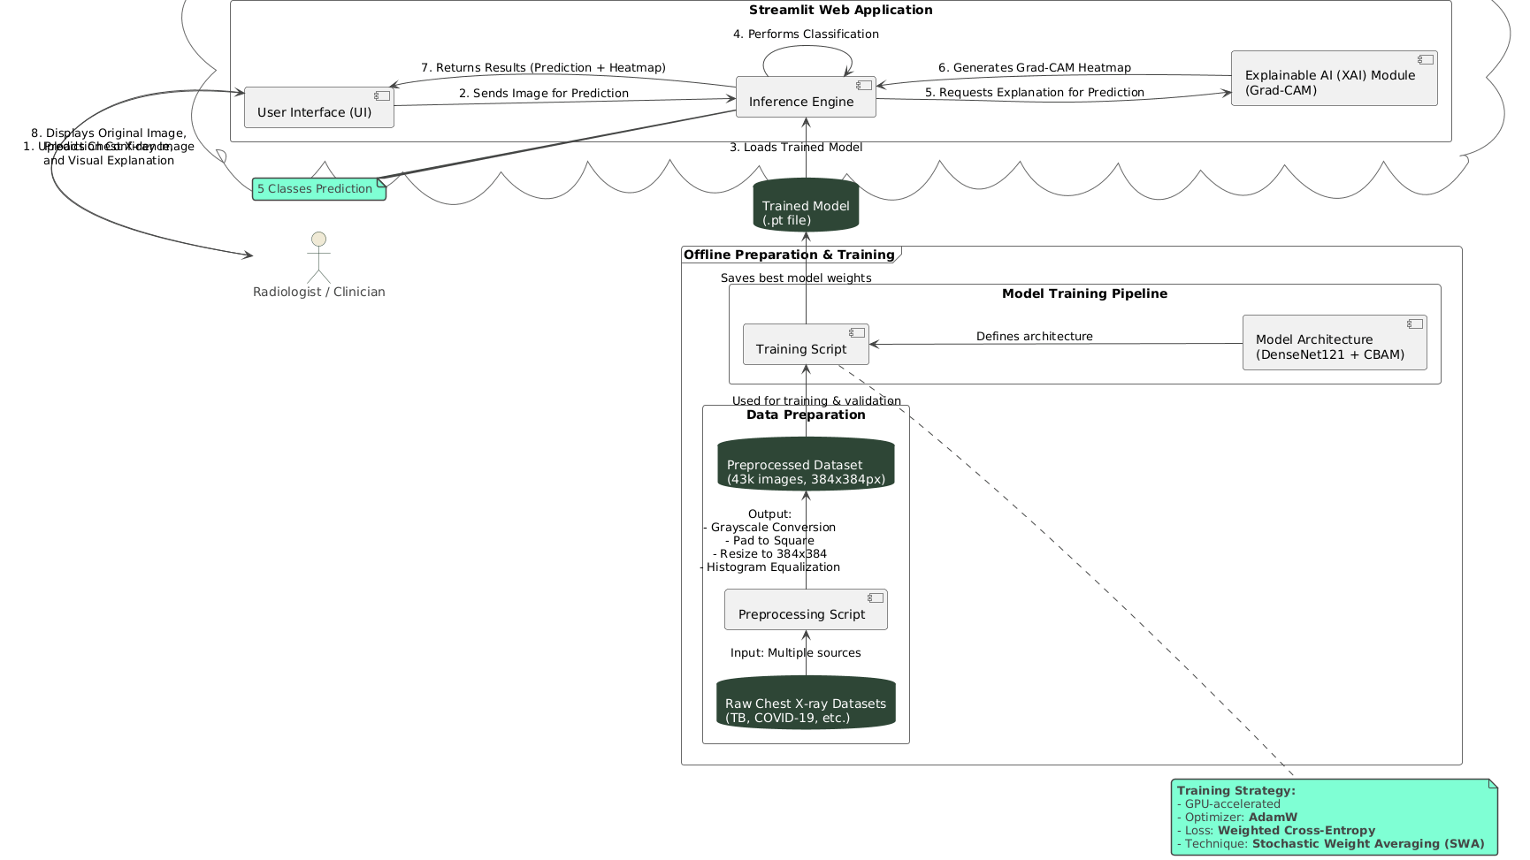

Slide 12
Disease | Image Count | Source
COVID-19 | 3,616 | COVID Radiography DB
Lung Opacity | 6,012 | COVID Radiography DB
Tuberculosis | 700 | TB Chest X-ray Dataset
Viral Pneumonia | 1,345 | COVID Radiography DB
Non-chest | 4,876 | X-ray Body Part Dataset

Slide 13

Dataset
Dataset 1:
Tuberculosis (TB) Chest X-ray Database
link: https://www.kaggle.com/datasets/tawsifurrahman/tuberculosis-tb-chest-xray-dataset
Dataset 2:
COVID-19 Radiography Database
Link: https://www.kaggle.com/datasets/tawsifurrahman/covid19-radiography-database
Dataset 3:
X‑Ray Body Part Dataset 512×512
Link: https://www.kaggle.com/datasets/yovinyahathugoda/x-ray-body-part-dataset-512x512?utm_source=chatgpt.com
Dataset 4 :
ImageNet1K1
Link : https://www.kaggle.com/datasets/sautkin/imagenet1k1?utm_source=chatgpt.com

Slide 14
Preprocessing Pipeline:
Grayscale conversion
Padding & resizing (256×256 px)
Histogram equalization
Augmentation (rotation, flip, zoom)
Removal of corrupted/duplicate files
70–20–10 Train/Val/Test split
OUTPUT & CONCLUSION
Model tested via Streamlit App:
Upload X-ray → Predict Disease → Show Heatmap (Grad-CAM)
Predictions accompanied by:
Confidence scores
Visual explanations for transparency
Achieved high accuracy across all disease categories.
Confusion matrix analysis confirmed robust generalization.

Slide 15
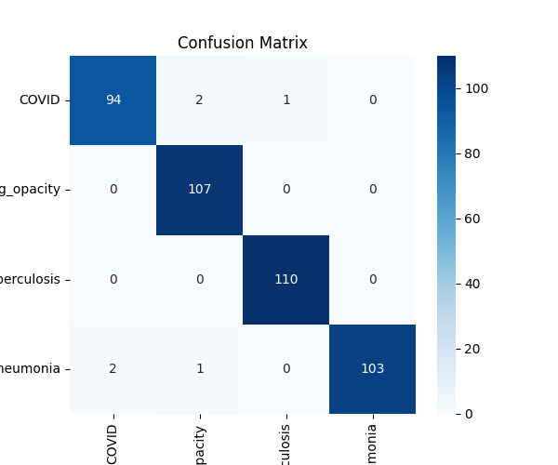
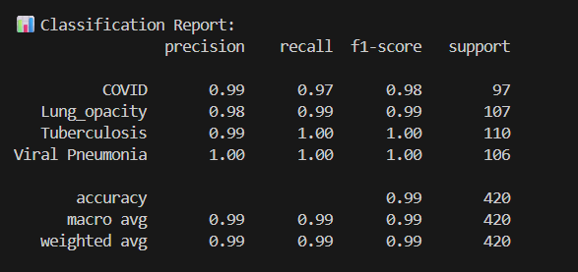

Slide 16
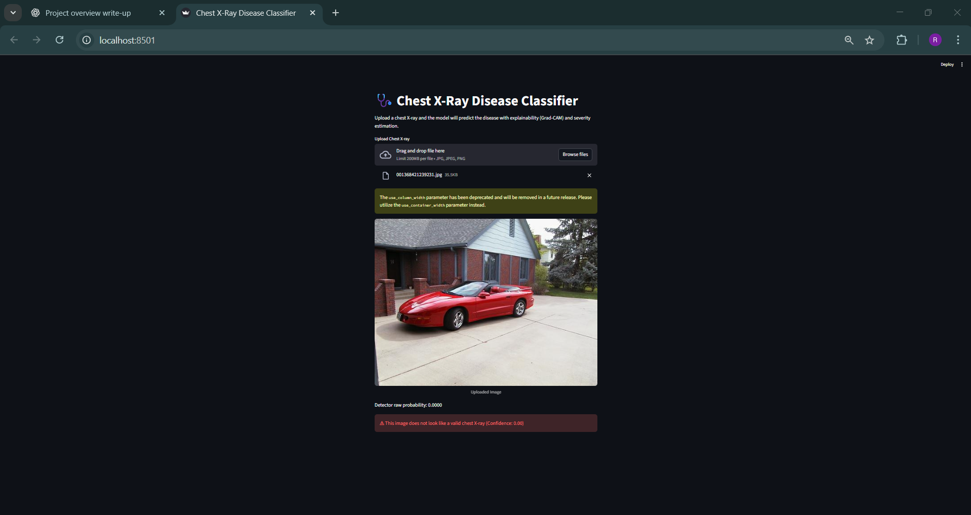

Slide 17
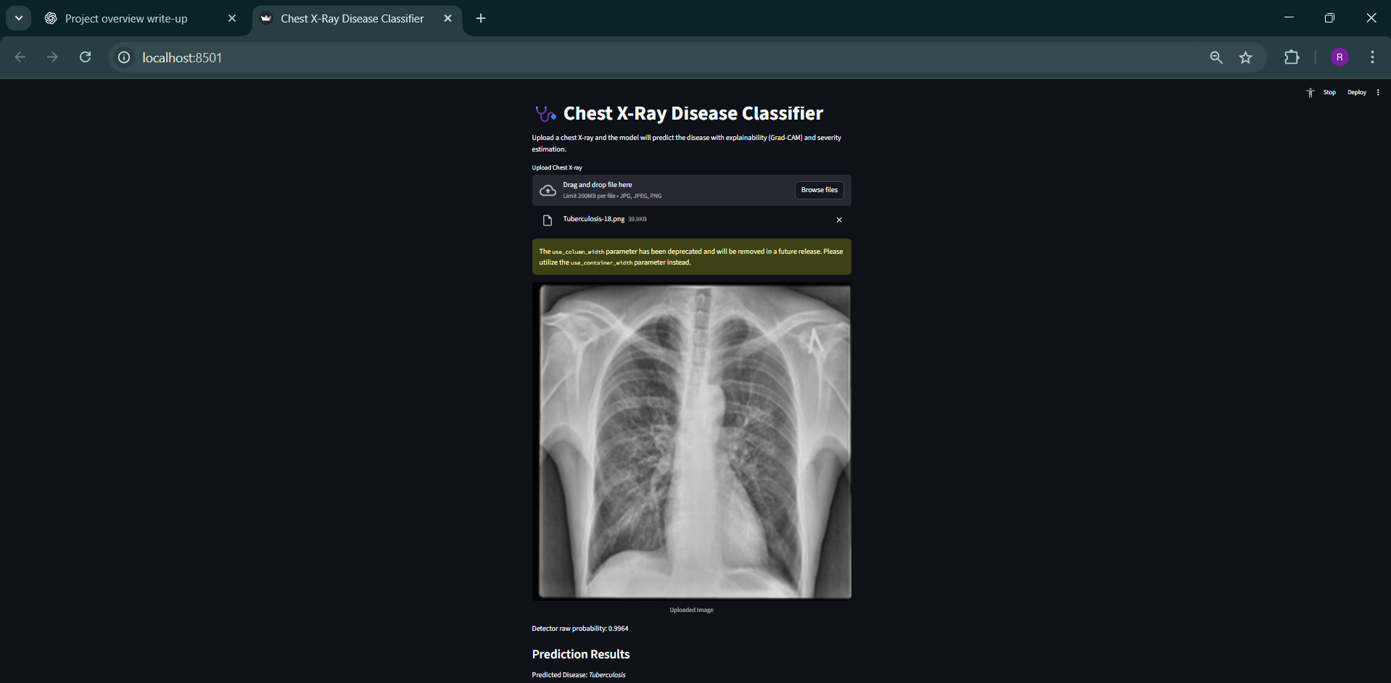

Slide 18
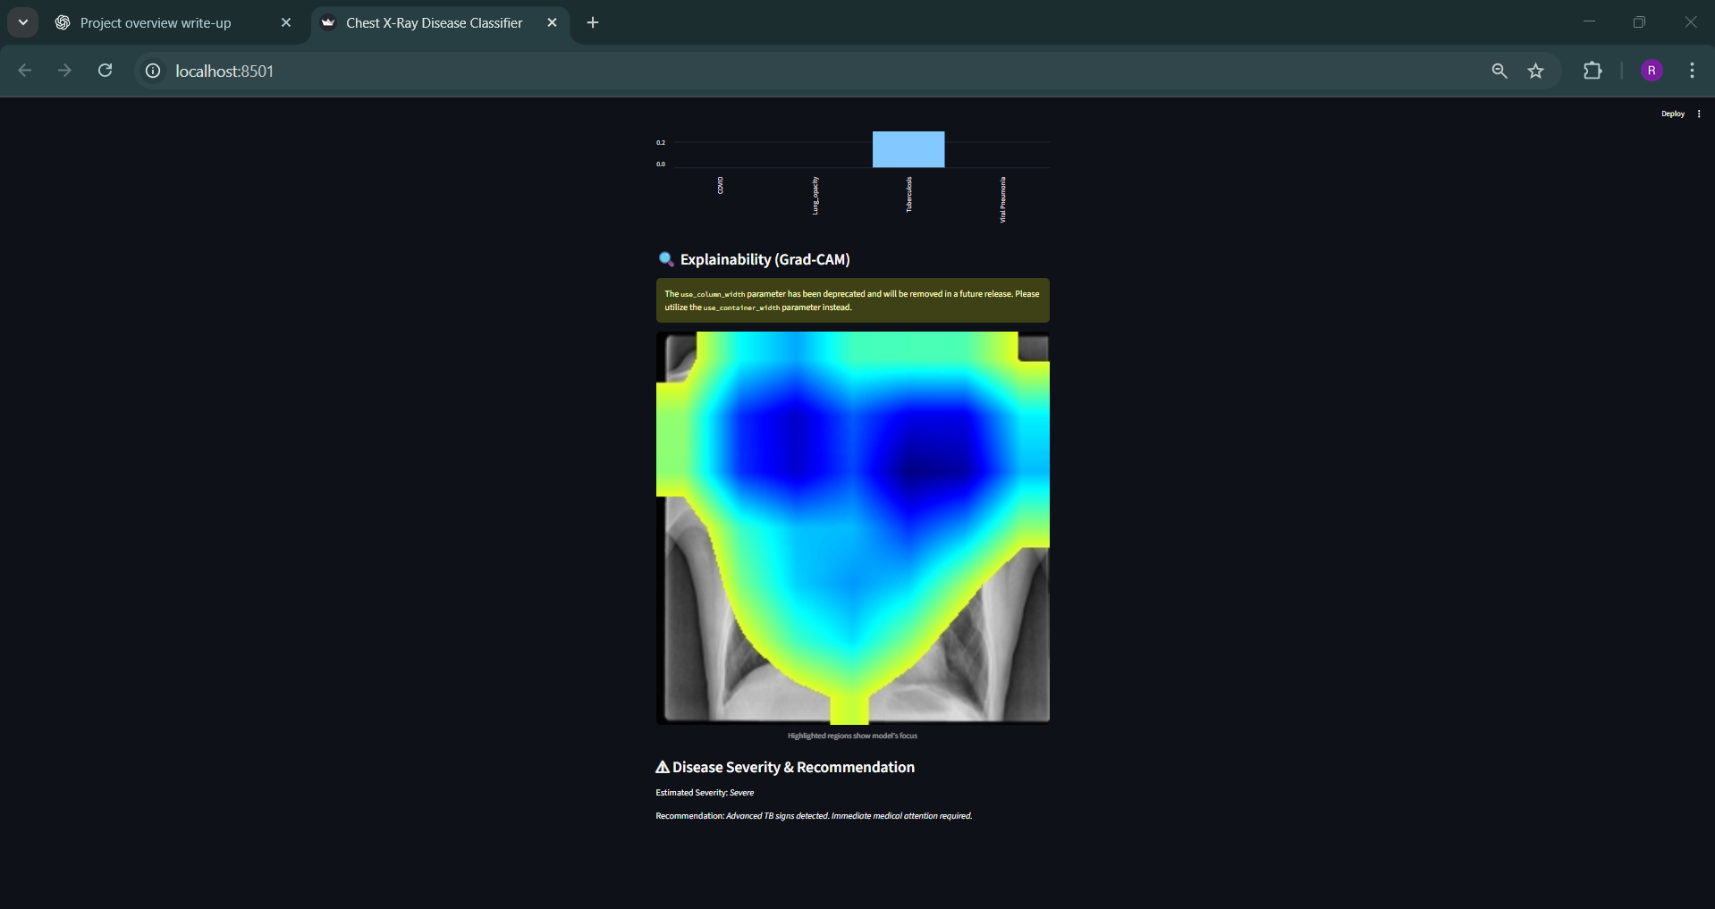

Slide 19
.
Conclusion :
Developed a Multi-Disease Chest X-ray Classifier using Explainable AI.
Combined DenseNet121 + Swin Transformer + CBAM for hybrid feature learning.
Achieved strong classification accuracy and high interpretability.
Deployed as an interactive web application for clinicians.
Key Benefits:
Reduced diagnosis time
Increased reliability
Enhanced interpretability for clinical trust
Future Work :
Extend dataset with new thoracic diseases (e.g., COPD, Lung Cancer).
Integrate multi-modal imaging (CT scans, MRI).
Enable federated learning for privacy-preserving collaboration.
Conduct clinical trials for model validation.
Develop mobile-friendly diagnostic apps for rural healthcare

Slide 20
References
Rajaraman, A., & Sivaswamy, A. (2020). Deep Learning for Chest X-ray Analysis: A Survey. IEEE Access, 8, 191462-191485.
This paper reviews the application of deep learning techniques, including DenseNet, for chest X-ray analysis.
Hemalatha, S., & Shashidhar, M. V. (2020). COVID-19 Chest X-ray Classification Using Deep Convolutional Neural Networks. Journal of Medical Imaging and Health Informatics, 10(3), 567-573.
This study explores using DenseNet for COVID-19 detection in chest X-ray images.
Litjens, M., Kooi, T., Bejnordi, B. E., et al. (2017). A Survey on Deep Learning in Medical Image Analysis. Medical Image Analysis, 42, 60-88.
This survey covers deep learning techniques applied to medical image analysis, including chest X-rays.
Kumar, R., & Narayan, N. S. (2020). Multi-Class Chest X-ray Classification Using DenseNet with CBAM Attention. Proceedings of the International Conference on Medical Imaging and Computational Methods (pp. 23-31).
This paper investigates using DenseNet and CBAM for multi-class chest X-ray disease classification.
Ribeiro, M. T., Singh, S., & Ghosh, K. (2016). Why Should I Trust You? Explaining the Predictions of Any Classifier. Proceedings of the 22nd ACM SIGKDD International Conference on Knowledge Discovery and Data Mining, 1135-1144.
This paper introduces Grad-CAM, a method for explaining predictions of convolutional neural networks

